Slide 1
WHACK HACKATHON 4.0
SMARTFARM- AI-POWERED SMART FARMING ASSISTANT
Using Satellite Data, Weather Intelligence, and AI to Optimize Irrigation and Improve Crop Health
Theme- Integrated Smart Irrigation & Crop Disease Prediction System
Problem Statement- Develop a low-cost AI and IoT-based system that predicts optimal daily irrigation needs and detects early-stage crop diseases using soil moisture data, weather forecasts, crop type, and image-based disease analysis.
Category- Software Integrated System
Team Name- TendToZero
--“Helping farmers make intelligent irrigation decisions using AI and satellite data.”--

Slide 2

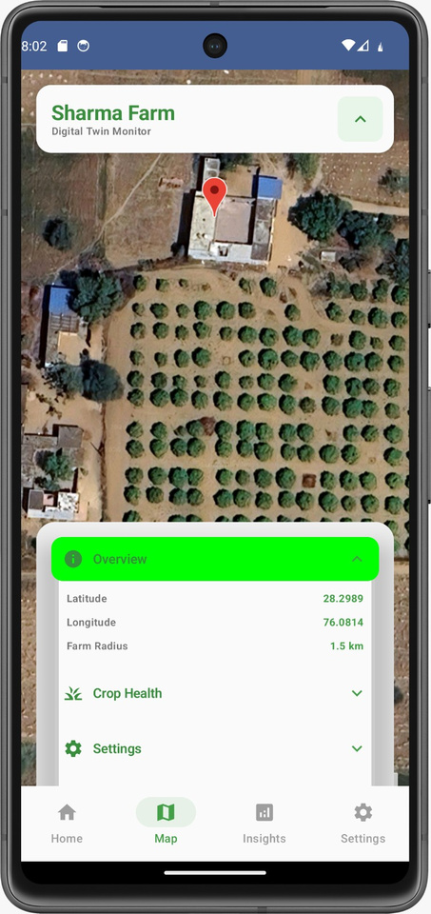
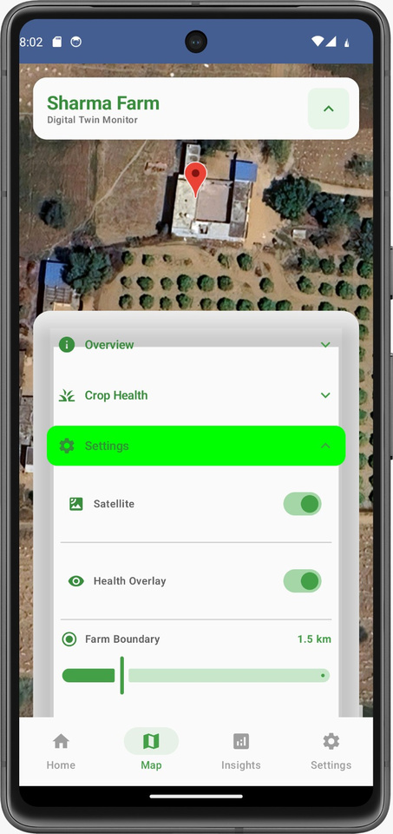
Proposed Solution
Geospatial Farm Monitoring and Settings
• Developed a smart farming mobile application for irrigation and crop monitoring (DIGITAL TWIN ).
• Uses real satellite data from NASA to monitor soil moisture and crop health
• Uses real-time weather data to analyze temperature, humidity, and rainfall
• Provides AI-based irrigation recommendations to prevent overwatering and underwatering
• Helps farmers monitor crop condition remotely using satellite insights
• Includes irrigation control system with automatic, manual, and scheduled modes
• Provides risk assessment and future prediction to help farmers make better decisions
Displays satellite-based geospatial visualization of the farm with real-time location mapping, enabling precise monitoring of farm boundaries, coordinates, and overall field layout.( DIGITAL TWIN )
Shows farm configuration and control panel with features such as satellite view toggle, crop health overlay, and adjustable farm radius, allowing customized monitoring and precision agriculture management.
3

Slide 3
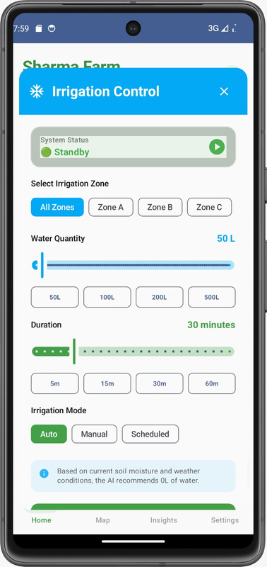
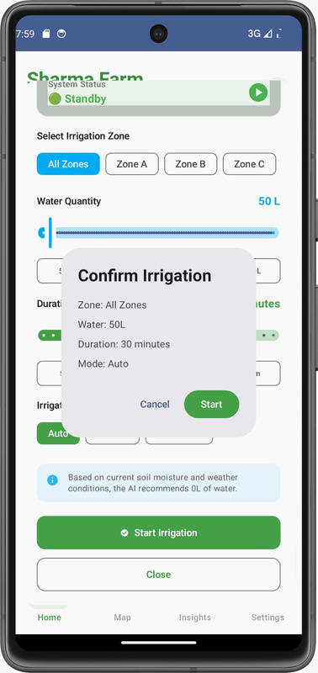
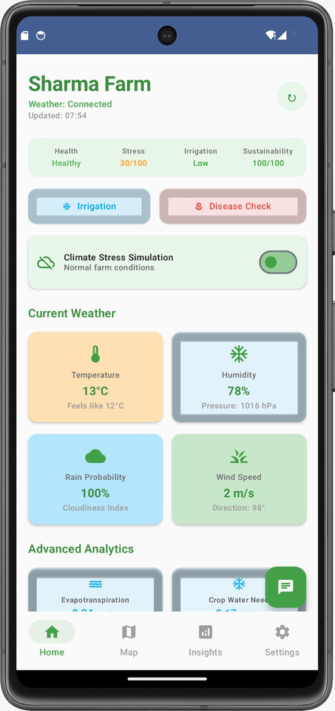
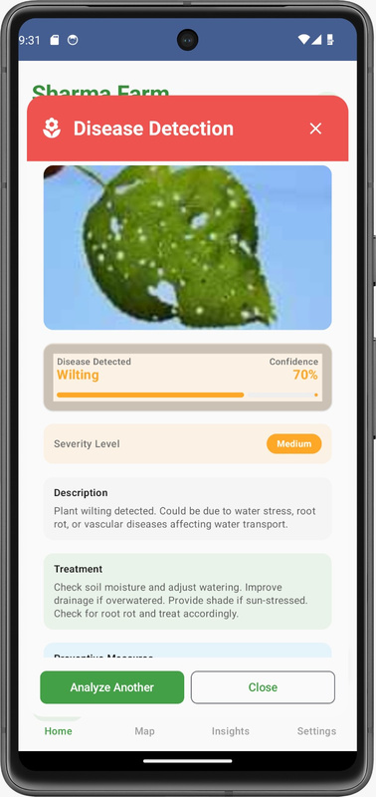
Centralized farm monitoring dashboard displaying real-time crop health, irrigation status, stress index, and sustainability metrics derived from satellite and weather data.
AI-based plant disease detection module using image analysis to identify crop diseases, estimate severity level, and provide treatment and preventive recommendations.
SYSTEM ARCHITECTURE & KEY FUNCTIONAL MODULES
Application Interface and System Modules
Intelligent agricultural assistant chatbot that provides real-time decision support, irrigation recommendations, crop health insights, and user guidance using AI-driven analysis and environmental data integration.
Automated irrigation control interface enabling zone selection, water volume configuration, irrigation duration scheduling, and mode selection using AI-driven irrigation recommendations.
Irrigation execution confirmation module displaying configured irrigation parameters including irrigation zone, water volume, duration, and operational mode prior to deployment.
3
3

Slide 4
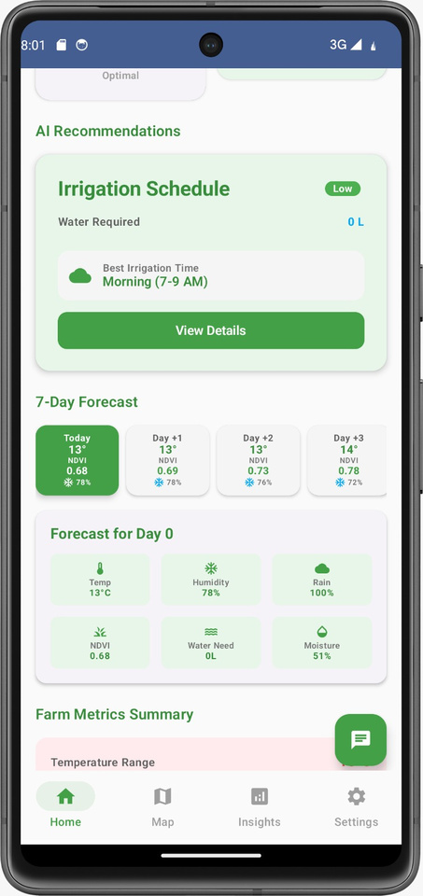
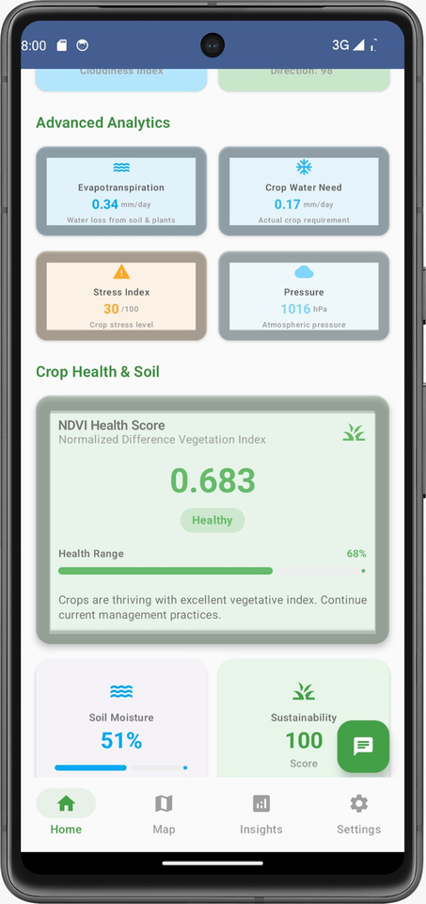
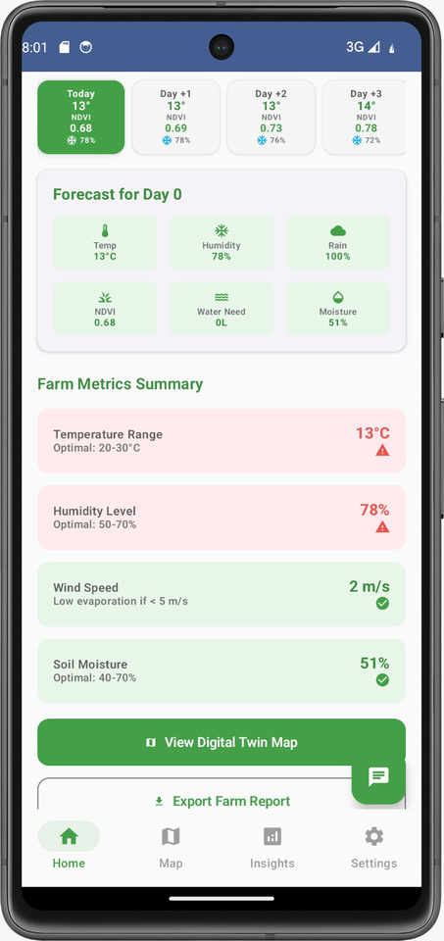
AI- DRIVEN ANALYTICS & IRRIGATION DECISION SUPPORT SYSTEM
• Integrates real-time weather data, soil moisture levels, and satellite-derived crop health metrics for accurate farm monitoring
• Calculates evapotranspiration rate and crop water requirement to determine precise irrigation needs
• Uses NDVI (Normalized Difference Vegetation Index) to analyze crop health and vegetation condition
• Provides AI-based irrigation scheduling including optimal water quantity, timing, and duration
• Displays 7-day weather forecast to enable predictive irrigation planning and risk prevention
• Monitors farm parameters such as temperature, humidity, wind speed, and soil moisture
• Generates crop stress index and sustainability score for performance evaluation
• Supports precision agriculture by optimizing water usage, improving crop yield, and reducing resource wastage

Slide 5
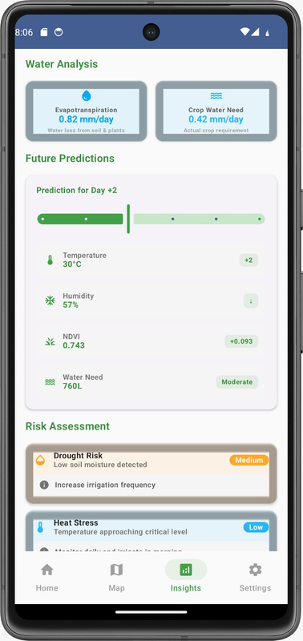
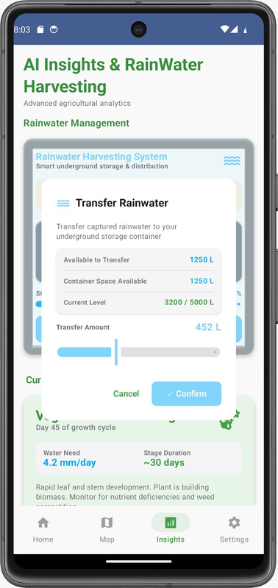
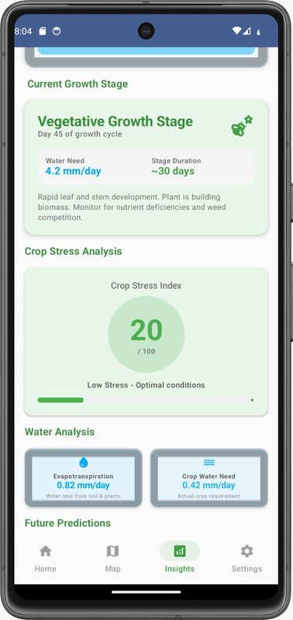
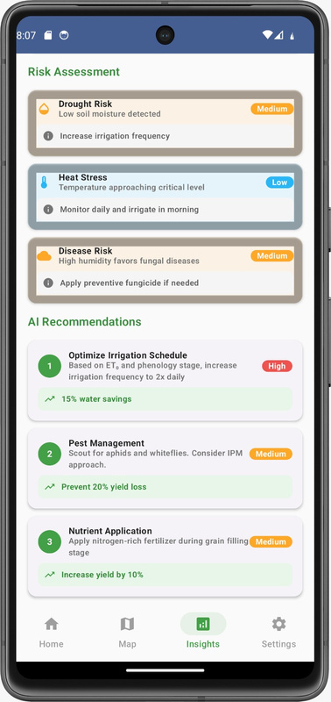
INNOVATION AND UNIQUENESS
Satellite-based crop growth stage monitoring and stress analysis using NDVI, evapotranspiration, and environmental parameters for precision agriculture.
• Implements an intelligent rainwater harvesting system for collection, monitoring, and efficient utilization of stored water resources
• Implements AI-based risk assessment to identify drought stress, heat stress, and crop health risks, enabling preventive decision-making
• Provides predictive environmental analytics to forecast future water demand and crop conditions
• Includes intelligent water resource monitoring for efficient water utilization and sustainability
• Supports multilingual user interface with Hindi and regional language options to improve accessibility and usability for farmers
AI-driven agricultural risk assessment system identifying drought, heat stress, and disease risks with automated irrigation and crop management recommendations.
Advanced water requirement analysis and predictive modeling using evapotranspiration data, weather forecasts, and satellite-derived environmental insights.
Smart rainwater management module for monitoring storage capacity, transfer volume, and efficient water resource utilization using automated distribution control.

Slide 6
Your Team Name
TECHNOLOGY STACK AND FUTURE SCOPE
Future Scope and Scalability
• Integration with real-time IoT sensors for enhanced accuracy
• Automated irrigation hardware integration
• Advanced AI models for crop yield prediction
• Expansion to support multiple crop types and regions
• Offline functionality for low connectivity areas
• Integration with government agricultural support systems
Technologies and Tools Used
• Frontend: Mobile Application (JETPACK COMPOSE)
• Backend: firebase
• Satellite Data: NASA Earth Observation datasets (NDVI)
• Weather Data: OpenWeather API
• Map Integration: Google Map
7

